Slide 1



Hotel Booking Analysis
M. Haroon Azam (2012126)
Rafay Suleman Durrani (2012139)
M. nESAR aHMED (2012127)

Slide 2
Introduction
The hotel booking demand dataset is a valuable resource for understanding the factors that influence hotel bookings. Information including such as the date of the booking, guests that are staying in the hotels and the length of stay are some parts of the dataset.
Data cleaning is an important step in preparing the hotel booking demand dataset for analysis. This process involves identifying and correcting any errors or inconsistencies in the data

Slide 3
df = pd.read_csv('F:/hotel_bookings.csv')
This line reads the CSV file located at the path 'F:/hotel_bookings.csv' and creates a pandas DataFrame object called "df". The read_csv() function is a pandas function that reads a CSV file and returns a DataFrame.
A DataFrame is a two-dimensional tabular data structure provided by the pandas library in Python. It is similar to a table in a relational database or a spreadsheet in Excel.
In a DataFrame, data is organized in rows and columns. Each column can have a different data type (such as numeric, string, or boolean), and each row represents a separate observation or record.

Slide 4
Some key features of a DataFrame include:
Missing Data Handling: DataFrames provide built-in support for handling missing or null values. They offer various methods for dealing with missing data, such as dropping rows or columns with missing values or filling them with appropriate values.
Data Manipulation: DataFrames offer powerful methods and functions for data manipulation, transformation, filtering, and aggregation. These operations make it easy to perform various data analysis tasks efficiently.
Overall, DataFrames are widely used in data analysis, data preprocessing, and data exploration tasks. They provide a convenient and flexible way to work with structured data in Python.

Slide 5
Df.info
In pandas, the info() method is used to display a concise summary of a DataFrame. When you call df.info() on a DataFrame df, it provides information about the DataFrame's structure, including:
The number of rows and columns in the DataFrame.
The column names and their respective data types.
The number of non-null values in each column.
The memory usage of the DataFrame.

Slide 6
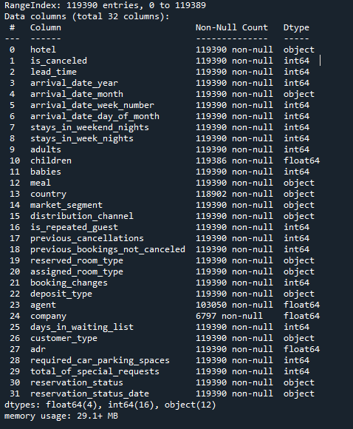
CODE
Output:
df = pd.read_csv('F:/hotel_bookings.csv') df.info()

Slide 7
df=df.drop(['company','agent'],axis=1) df.head()
The code df = df.drop(['company', 'agent'], axis=1) removes the columns named 'company' and 'agent' from the DataFrame df. The drop() method in pandas is used to drop specified rows or columns from a DataFrame.
After executing this code, the DataFrame df will no longer contain the 'company' and 'agent' columns, as they have been removed.

Slide 8
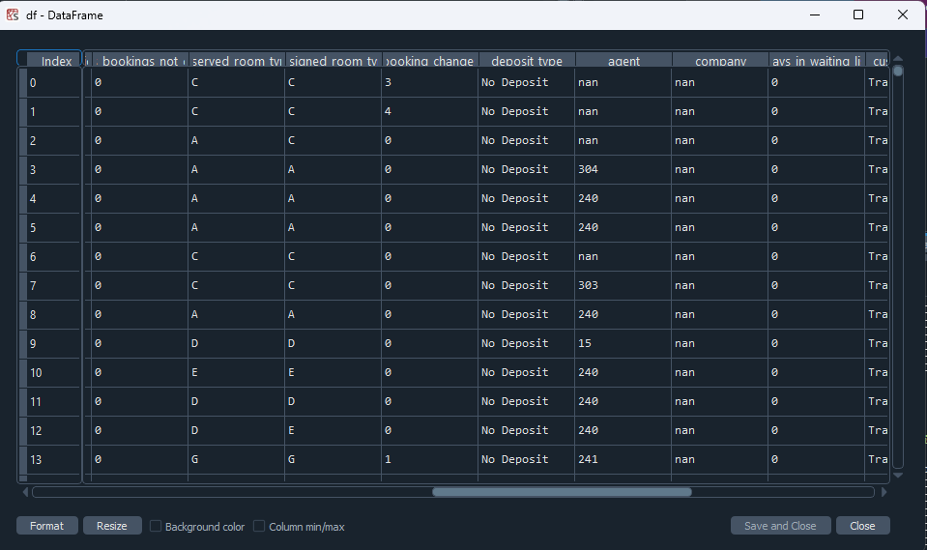
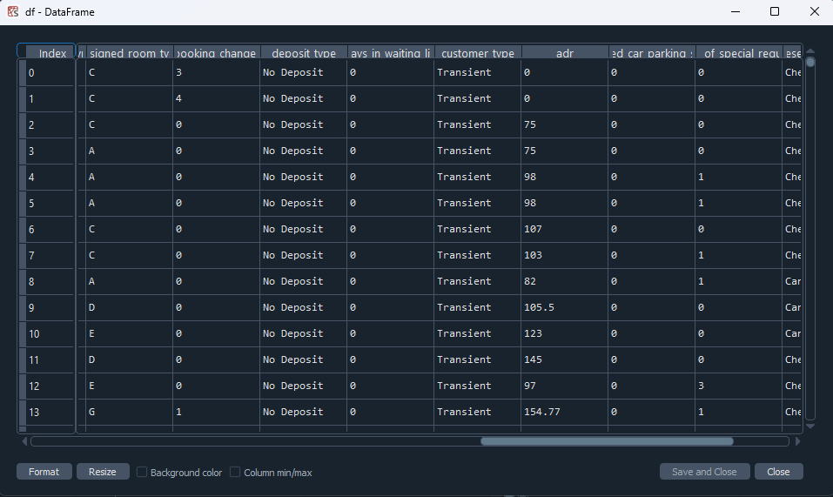
Removed from here

Slide 9
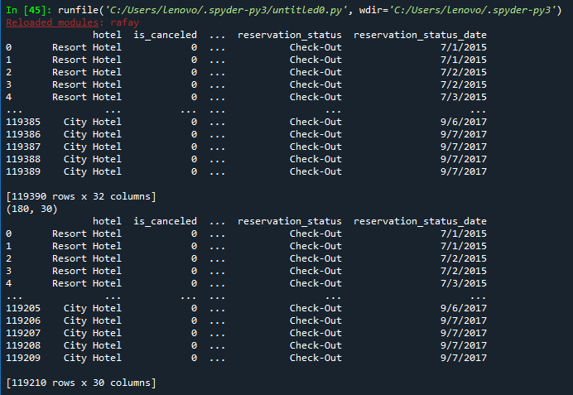
Checking where there is no guests.
df[df.adults + df.babies + df.children == 0].shape
These rows does not make any sense, so we are gonna delete these rows.
CODE:
df = df.drop(df[(df.adults + df.babies + df.children == 0)].index).reset_index(drop=True)

Slide 10
What number of bookings were cancelled
The code booking_info = pd.DataFrame(df.groupby('hotel')['is_canceled'].value_counts()) creates a new DataFrame called booking_info that contains the counts of canceled and non-canceled bookings grouped by the 'hotel' column in the original DataFrame df.
By executing booking_info = pd.DataFrame(df.groupby('hotel')['is_canceled'].value_counts()), you will obtain a DataFrame booking_info with three columns: 'hotel', 'is_canceled', and 'count'. The 'hotel' column represents the hotel names, the 'is_canceled' column represents whether a booking is canceled (1) or not (0), and the 'count' column represents the number of occurrences for each combination of hotel and cancellation status.

Slide 11
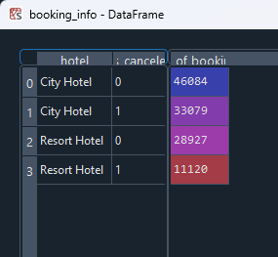
This information can be useful for analyzing booking cancellation patterns between different hotels in the dataset.

Slide 12
Finding percentage of cancelled bookings
CODE:
The code booking_info['percentage'] = df.groupby('hotel')['is_canceled'].value_counts(normalize=True) * 100 adds a new column named 'percentage' to the DataFrame booking_info. The values in this column represent the percentage of canceled and non-canceled bookings for each hotel, calculated based on the value counts obtained from the df.groupby('hotel')['is_canceled'].value_counts(normalize=True) expression.
booking_info['percentage']=df.groupby('hotel')['is_canceled'].value_counts(normalize=True)*100

Slide 13
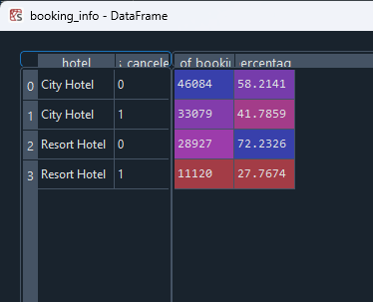
By executing this code, the DataFrame booking_info will have a new column named 'percentage' containing the calculated percentages of canceled and non-canceled bookings for each hotel.

Slide 14
plot showing the number of canceled and non-canceled bookings for each hotel type
CODE:
plt.rcParams['figure.figsize'] = (9, 4) sns.countplot(x='hotel',data=df,hue='is_canceled',palette='husl',ec='black',lw=1).set(xlabel='Hotels') plt.title('Booking Cancelled or not by Hotel Type') plt.grid(True) plt.show()

Slide 15
Describing the code
plt.rcParams['figure.figsize'] = (9, 4): This line sets the default figure size for plots to (9, 4), which means the width will be 9 inches and the height will be 4 inches.
sns.countplot(x='hotel', data=df, hue='is_canceled', palette='husl', ec='black', lw=1): This line creates a countplot using Seaborn. It specifies the DataFrame df as the data source, the 'hotel' column as the x-axis variable, the 'is_canceled' column as the hue variable (to differentiate between canceled and non-canceled bookings), and uses the 'husl' color palette. The ec (edgecolor) parameter sets the color of the bars' edges, and lw (linewidth) parameter sets the width of the bar edges.
.set(xlabel='Hotels'): This sets the x-axis label of the plot to 'Hotels'.
plt.title('Booking Cancelled or not by Hotel Type'): This sets the title of the plot to 'Booking Cancelled or not by Hotel Type'.
plt.grid(True): This adds gridlines to the plot.
plt.show(): This displays the plot.

Slide 16
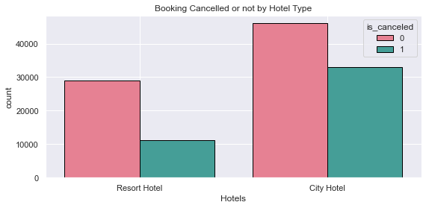
Which type of hotel has more booking ?
CODE:
preference = pd.DataFrame(df.hotel.value_counts()) preference['percentage']=df.hotel.value_counts(normalize=True)*100 preference.index.name='hotel' preference

Slide 17
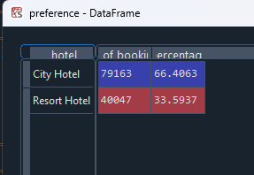
Describing
Preference : It counts the occurrences of each unique hotel type and creates a DataFrame with the counts.
preference['percentage'] = df.hotel.value_counts(normalize=True) * 100: This line adds a new column named 'percentage' to the DataFrame preference. It calculates the percentages of each hotel type by dividing the counts by the total count of hotels and multiplying by 100.

Slide 18
Generates a list called labels that contains the unique hotel types from the 'hotel' column
CODE:
labels=df['hotel'].value_counts().index.tolist() labels sizes=df['hotel'].value_counts().tolist() sizes

Slide 19
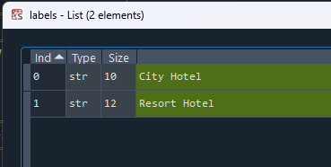
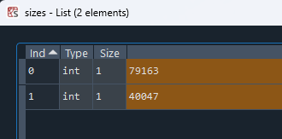
Description
df['hotel'].value_counts(): This counts the occurrences of each unique hotel type in the 'hotel' column of the DataFrame.
index.tolist(): This accesses the index of the resulting Series (which contains the unique hotel types) and converts it to a list.

Slide 20
Making a pie chart of which type of hotel has more booking
CODE:
colors=['yellowgreen','lightcoral'] colors explode=(0,0.1) explode plt.pie(sizes,labels=labels,colors=colors,autopct="%1.1f%%",explode=explode,startangle=90,textprops={'fontsize': 14}) plt.show()

Slide 21
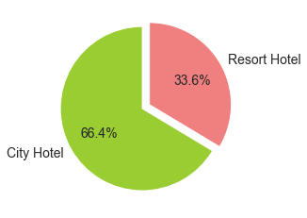
Description:
By executing this code, you will see a pie chart with two sections representing the different hotel types. The first section will have the color 'yellowgreen' and the second section will have the color 'lightcoral'.

Slide 22
Which month has the highest number of arrivals
CODE:
confirmed_booking=df.loc[df.is_canceled==0] confirmed_booking.head() confirmed_booking.reset_index(drop=True,inplace=True) confirmed_booking.head() people_arrival_count_df=pd.DataFrame(confirmed_booking['arrival_date_month'].value_counts()) people_arrival_count_df.head()

Slide 23
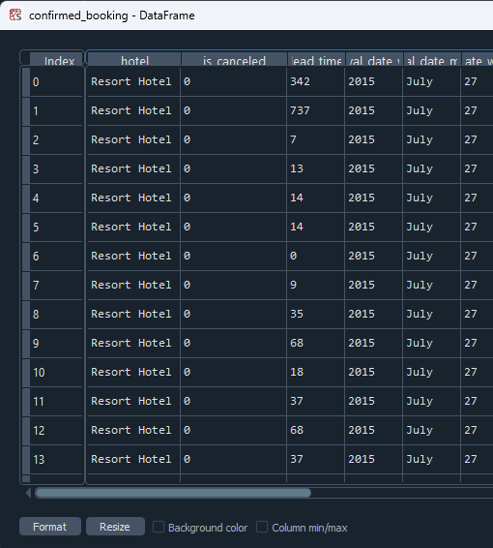
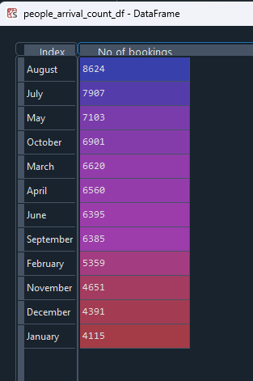
Description:
confirmed_booking = df.loc[df.is_canceled == 0]: This line filters the DataFrame df to include only the rows where the 'is_canceled' column has a value of 0, indicating confirmed bookings. The resulting DataFrame is assigned to confirmed_booking.
people_arrival_count_df = pd.DataFrame(confirmed_booking['arrival_date_month'].value_counts()): This line creates a new DataFrame called people_arrival_count_df that counts the occurrences of each unique value in the 'arrival_date_month' column of the confirmed_booking DataFrame. The resulting DataFrame contains the count of people arriving each month.
By executing this code, you will obtain the confirmed_booking DataFrame that includes only the confirmed bookings, and the people_arrival_count_df DataFrame that contains the count of people arriving each month based on the confirmed bookings.

Slide 24
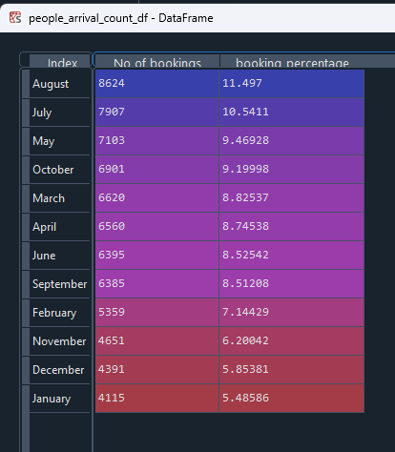
Percentage In Which month has the highest number of arrivals
CODE:
people_arrival_count_df['booking_percentage'] =confirmed_booking['arrival_date_month'].value_counts(normalize=True)*100 people_arrival_count_df

Slide 25
Plotting a graph representing the count of bookings for each month
CODE:
confirmed_booking['arrival_date_month'].value_counts().plot(kind='bar').set(xlabel=('Month'),ylabel=('Bookings count')) plt.show()

Slide 26
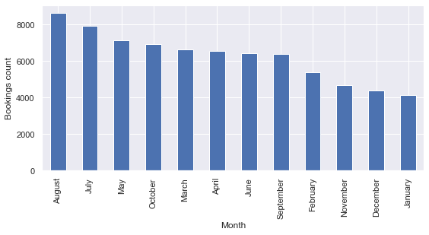
Desciprtion
confirmed_booking['arrival_date_month'].value_counts(): This line calculates the value counts of each unique value in the 'arrival_date_month' column of the confirmed_booking DataFrame. It returns a Series object with the counts.
.plot(kind='bar'): This line calls the plot() function on the resulting Series, specifying the kind of plot as a bar plot. It creates a bar plot of the counts of bookings for each month.
.set(xlabel='Month', ylabel='Bookings count'): This line sets the x-label of the plot as 'Month' and the y-label as 'Bookings count' using the set() function.
plt.show(): This line displays the bar plot.
By executing this code, you will see a bar plot representing the count of bookings for each month based on the confirmed_booking DataFrame. The x-axis will represent the months, and the y-axis will represent the count of bookings. The plot will have labeled x and y axes.

Slide 27
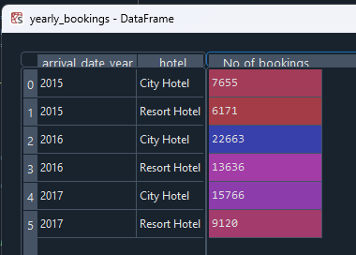
Which year has highest number of arrivals
CODE:
yearly_bookings=pd.DataFrame(confirmed_booking.groupby('arrival_date_year')['hotel'].value_counts()) yearly_bookings yearly_bookings.columns=['No of bookings'] yearly_bookings

Slide 28
Plotting graph for yeaRly booking (highest number of arrivals
CODE:
sns.countplot(x='arrival_date_year',data=confirmed_booking,hue='hotel').set_title('Yearly Bookings') plt.show()

Slide 29
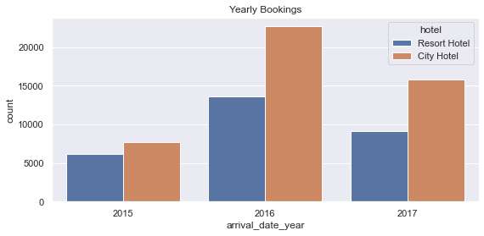
Description
sns.countplot(x='arrival_date_year', data=confirmed_booking, hue='hotel'): This line creates a countplot using Seaborn's countplot() function. It specifies the DataFrame confirmed_booking as the data source, the 'arrival_date_year' column as the x-axis variable, and the 'hotel' column as the hue variable. This will create bars for each year, and the bars will be further differentiated by the 'hotel' column.
.set_title('Yearly Bookings'): This line sets the title of the plot as 'Yearly Bookings' using the set_title() function.
plt.show(): This line displays the plot.

Slide 30
From which country people are comming the most
CODE:
country=pd.DataFrame(confirmed_booking.country.value_counts()) country country.columns=['no of bookings'] country

Slide 31
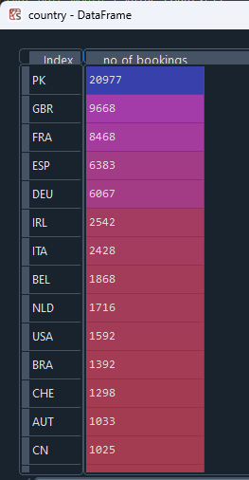
Description
country = pd.DataFrame(confirmed_booking.country.value_counts()): This line creates a DataFrame called country using the value_counts() function on the 'country' column of the confirmed_booking DataFrame. It counts the occurrences of each unique country and creates a DataFrame with the counts.
country: This line displays the country DataFrame, which contains the count of bookings for each unique country based on the confirmed_booking DataFrame.

Slide 32
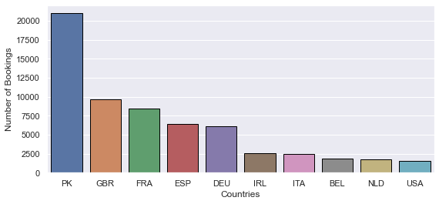
Plotting country to represent where people are coming from
CODE:
sns.barplot(x=list(confirmed_booking.country.value_counts().head(10).keys()),y=list(confirmed_booking.country.value_counts().head(10)),ec='black',lw=1) plt.xlabel('Countries') plt.ylabel('Number of Bookings') plt.show()

Slide 33
Which is the most reserved room type
CODE:
room_type=pd.DataFrame(df.reserved_room_type.value_counts(normalize=True)*100) room_type room_type.columns=['booking percentage'] room_type

Slide 34
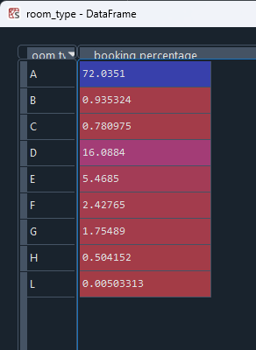
Description
room_type = pd.DataFrame(df.reserved_room_type.value_counts(normalize=True) * 100): This line creates a DataFrame called room_type using the value_counts() function on the 'reserved_room_type' column of the df DataFrame. It counts the occurrences of each unique reserved room type and calculates the percentage by using normalize=True and multiplying by 100. The resulting DataFrame contains the percentage of bookings for each room type.
room_type: This line displays the room_type DataFrame, which contains the percentage of bookings for each unique reserved room type based on the df DataFrame.
room_type.columns = ['booking percentage']: This line renames the column of the room_type DataFrame to 'booking percentage'. It assigns a new column name to the DataFrame's column attribute.

Slide 35
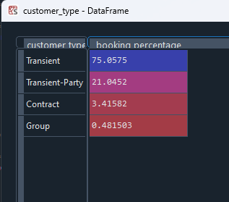
What is the most common customer type
CODE:
customer_type=pd.DataFrame(df.customer_type.value_counts(normalize=True)*100) customer_type customer_type.columns=['booking percentage'] customer_type

Slide 36
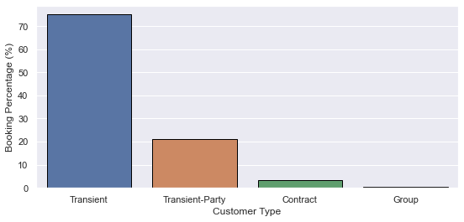
Plotting a graph
CODE:
list(customer_type['booking percentage']) list(customer_type.index) sns.barplot(y=list(customer_type['booking percentage']),x=list(customer_type.index),ec='black',lw=1).set(xlabel='Customer Type',ylabel='Booking Percentage (%)') plt.show()

Slide 37
CONCLUSION
Majority of the hotels are City Hotel, so we have to spend more money on these types of hotels.
Most number of bookings occured in summer months, so we have to target these summer months to increase the hotel business.
Most of the guests are from western nations, so we have to spent more time and money on those nations so that the hotel business will grow more on those nations.
Most of the guests are Transient, so we can target these types of guests to increase the number of booking.

